Slide 1
SMART PARKING

Slide 2
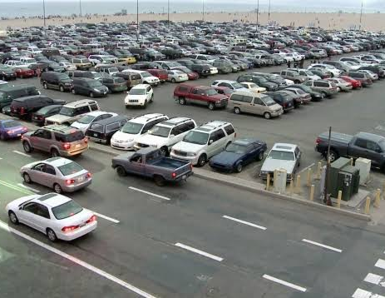
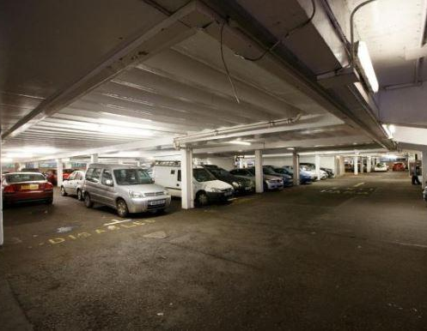

Problem Statement
The current business problem statement is that there is a need of a system which could manage parking of vehicles in parking areas automatically . Due to increase in number of vehicles day by day, authorities are facing problem in managing vehicles in parking areas. For this, there is a need of a system which can solve this issue . They need a system which could lessen the burden on employees.

Slide 3


Features
NOTIFICATION
GREAT SUPPORT
SEARCH PARKING SPACE
SCAN QR-CODE

Slide 4

Future Prospective

Slide 5
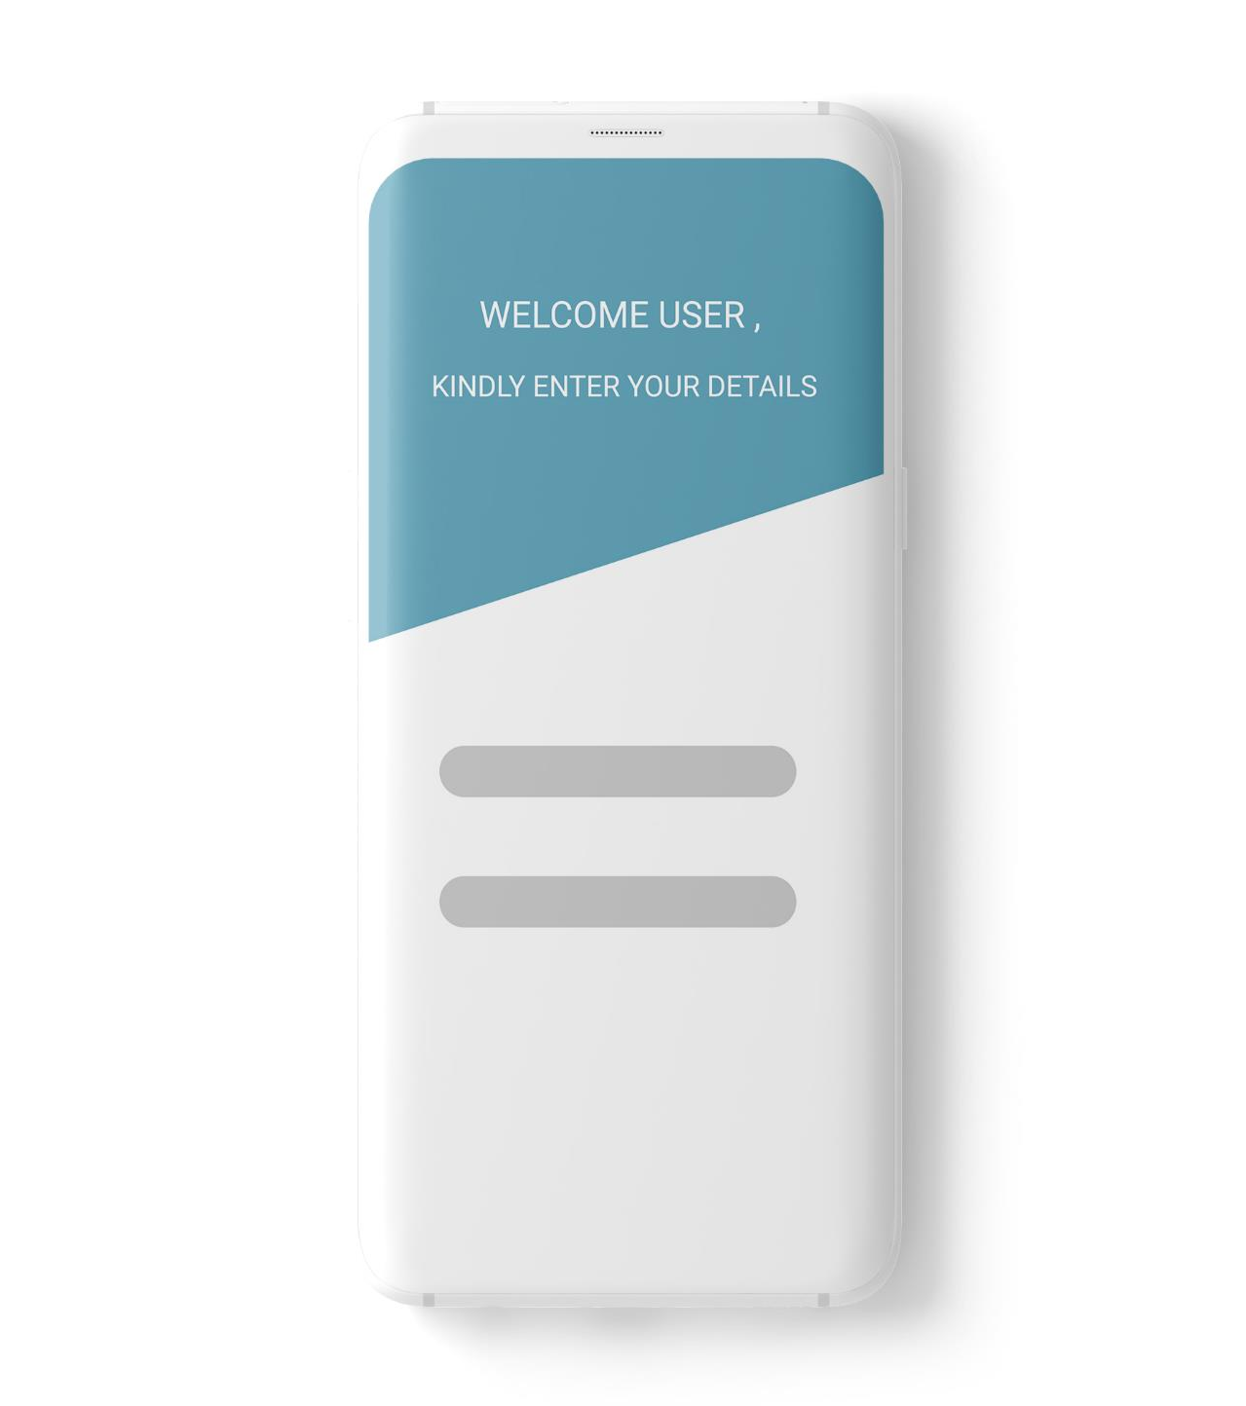
REGISTRATION & LOGIN

Slide 6
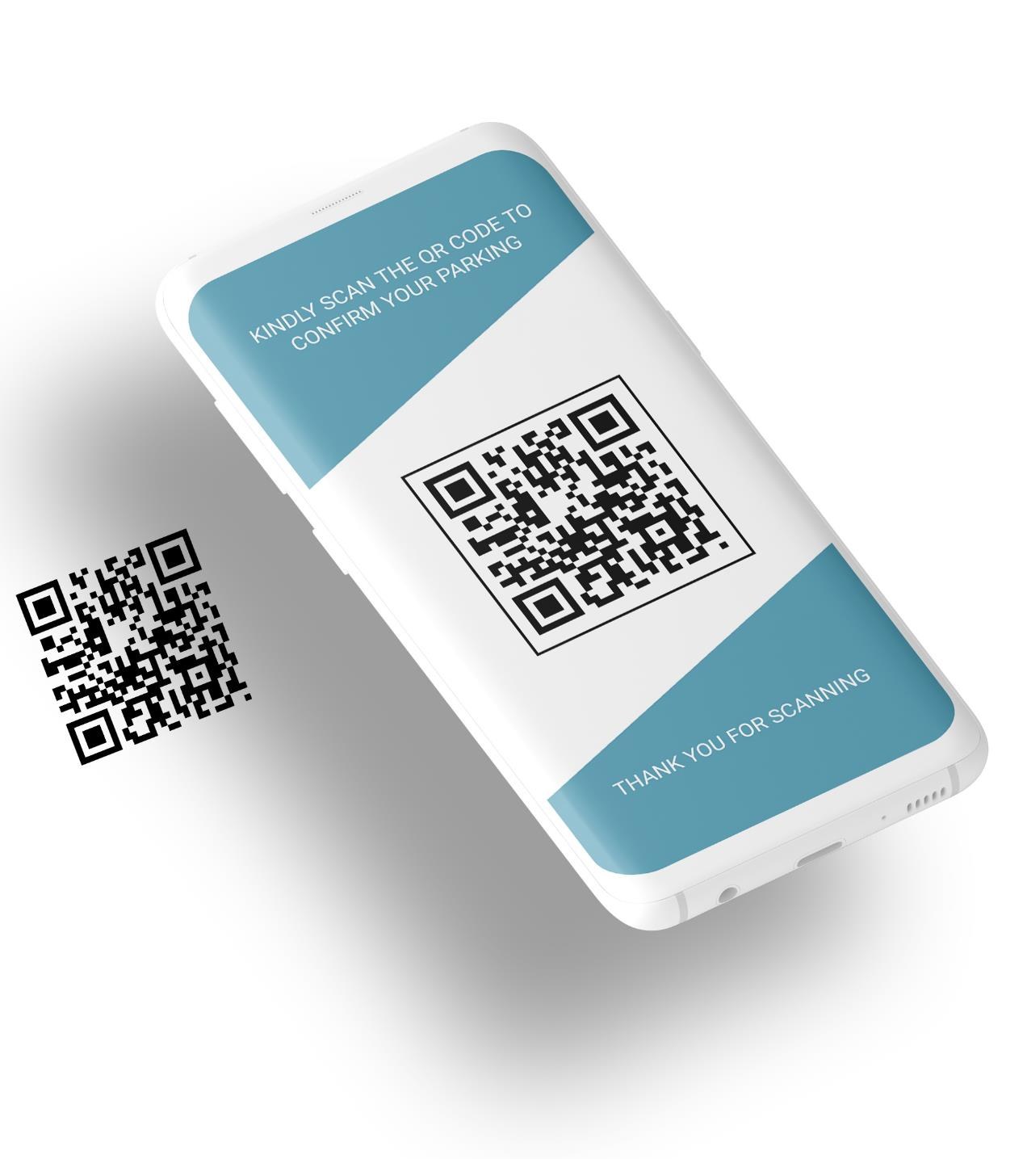
SCAN TO CONFIRM

Slide 7
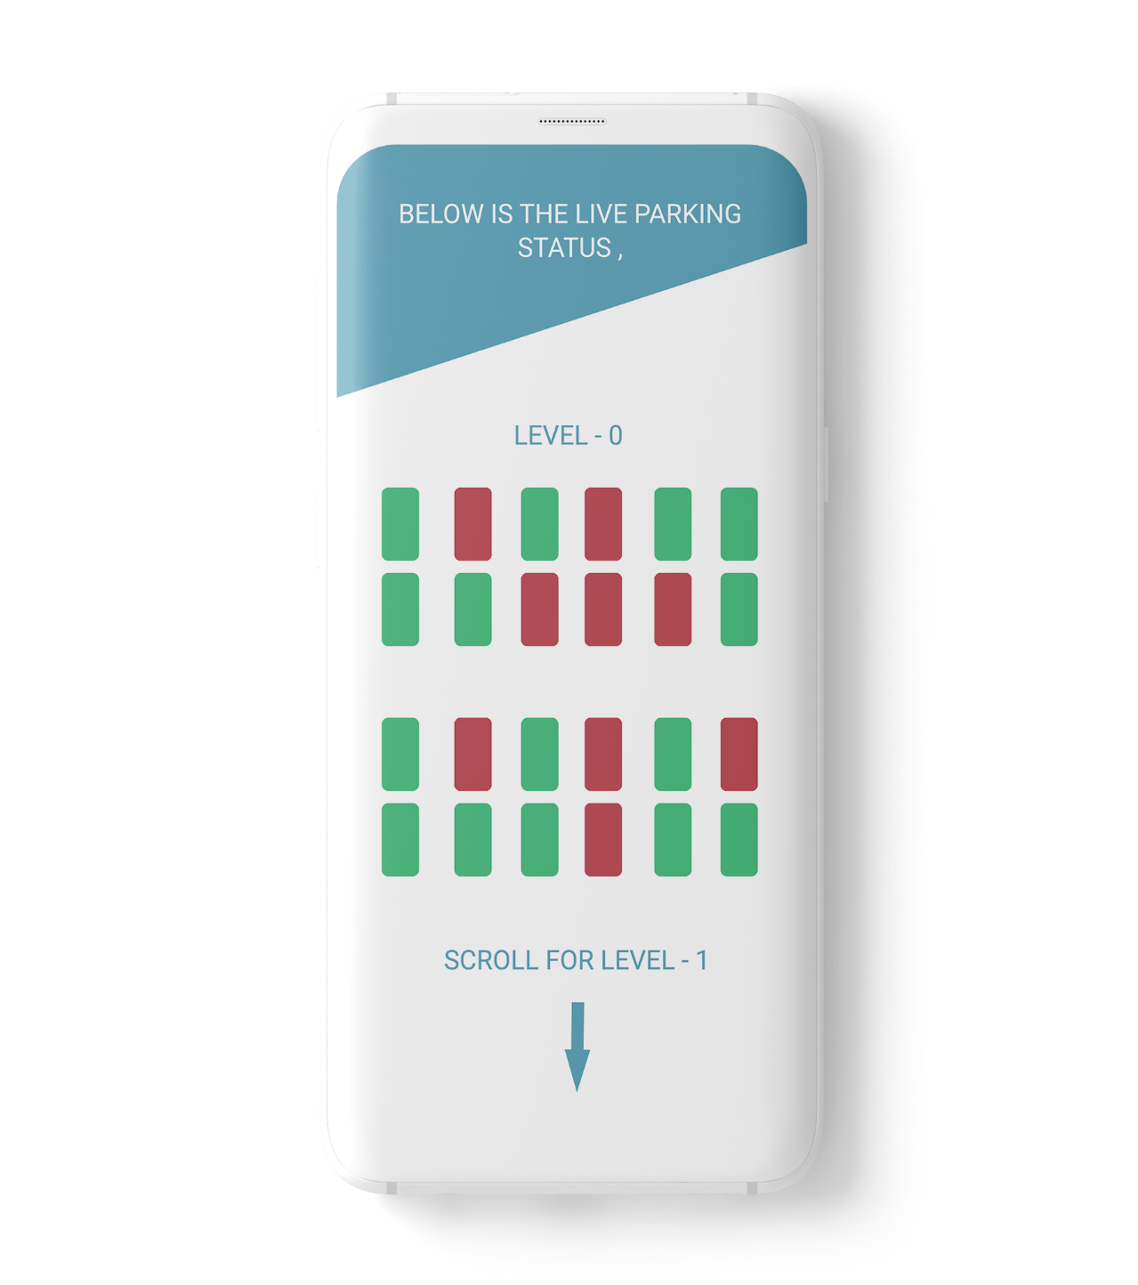
ACCESS LIVE PARKING

